Slide 1




Sustainable Public Procurement:
Sailing into Uncharted Waters
Roberto Caranta
This project has received funding from the European Union’s Horizon 2020 research and innovation
programme under the Marie Skłodowska-Curie grant agreement No 956696.

Slide 2
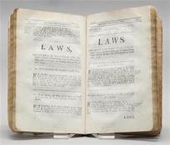
Part 1: recent developments in sustainable procurement
Part 2: new sectorial legislation and practical challenges in procurement procedures
Part 3: possible effects on review bodies
This project has received funding from the European Union’s Horizon 2020 research and innovation
programme under the Marie Skłodowska-Curie grant agreement No 956696.

Slide 3
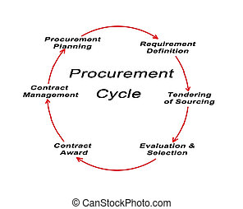

This project has received funding from the European Union’s Horizon 2020 research and innovation
programme under the Marie Skłodowska-Curie grant agreement No 956696.
EU Law Focus(ed)
On How to Buy
Market opening instruments
Coverage
Tech specs/contract performance clauses
Selection of the contractor/exclusion criteria
Award procedures

Slide 4

recent developments
in sustainable procurement

Slide 5


This project has received funding from the European Union’s Horizon 2020 research and innovation
programme under the Marie Skłodowska-Curie grant agreement No 956696.
Clean Vehicles
NEW Directive 2019/11/61 on clean vehicles
Minimum MS specific targets
reporting and review clause
MSs have to meet at least half of the procurement target for clean buses through the procurement of zero-emission buses

Slide 6

How is it done?
Policy docs
Reform proposals
Legislation
Implementing measures (Comm or MSs)
This project has received funding from the European Union’s Horizon 2020 research and innovation
programme under the Marie Skłodowska-Curie grant agreement No 956696.

Slide 7

This project has received funding from the European Union’s Horizon 2020 research and innovation
programme under the Marie Skłodowska-Curie grant agreement No 956696.
EUROPEAN GREEN DEAL
Climate change and environmental degradation are an existential threat to Europe and the world.
To overcome these challenges, the European Green Deal will transform the EU into a modern, resource-efficient and competitive economy, ensuring:
no net emissions of greenhouse gases by 2050
economic growth decoupled from resource use
no person and no place left behind
https://eur-lex.europa.eu/legal-content/EN/TXT/?qid=1588580774040&uri=CELEX%3A52019DC0640

Slide 8
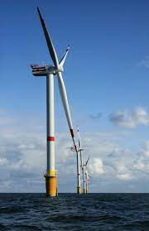
This project has received funding from the European Union’s Horizon 2020 research and innovation
programme under the Marie Skłodowska-Curie grant agreement No 956696.
Stepping up Europe’s 2030 climate ambition Investing in a climate-neutral future for the benefit of our people - COM(2020) 562 final
https://eur-lex.europa.eu/legal-content/EN/TXT/?uri=CELEX%3A52020DC0562
establishing minimum mandatory green public procurement criteria and targets in relation to renewable energy may also be needed

Slide 9

This project has received funding from the European Union’s Horizon 2020 research and innovation
programme under the Marie Skłodowska-Curie grant agreement No 956696.
A Renovation Wave for Europe –
greening our buildings, creating jobs, improving lives COM(2020) 662 final
by June 2022, the Commission will look into the possibility to develop green public procurement criteria for public buildings such as office buildings and schools related to life-cycle and climate resilience and based on Level(s)

Slide 10

new sectorial legislation and practical challenges in procurement procedures

Slide 11

This project has received funding from the European Union’s Horizon 2020 research and innovation
programme under the Marie Skłodowska-Curie grant agreement No 956696.
Regulation (EU) 2023/1115 on the making available on the Union market and the export from the Union of certain commodities and products associated with deforestation and forest degradation
Art. 25(2)(d) temporary exclusion for a maximum period of 12 months from public procurement processes and from access to public funding, including tendering procedures, grants and concessions
Commission to manage data base of final judgments
Self-cleaning arguably possible

Slide 12

EED
Directive (EU) 2023/1791 on energy efficiency and amending Regulation (EU) 2023/955 (recast)
art. 5 - public bodies to achieve an annual energy consumption reduction of 1.9%
Art. 6 - 3% of public buildings renovated each yeat to achieve nZEB
Art. 7 CA/Es purchase only products, services buildings and works with high energy-efficiency performance in accordance with the requirements in Annex IV, unless it is not technically feasible
This project has received funding from the European Union’s Horizon 2020 research and innovation
programme under the Marie Skłodowska-Curie grant agreement No 956696.

Slide 13

This project has received funding from the European Union’s Horizon 2020 research and innovation
programme under the Marie Skłodowska-Curie grant agreement No 956696.
RED III
Directive (EU) 2023/2413 - promotion of energy from renewable sources
reforms Art. 15(2) Dir. 2018/2001 “2. MSs shall clearly define any technical specifications which are to be met by renewable energy equipment and systems in order to benefit from support schemes and to be eligible under public procurement. ”
new Art. 15a(4) MSs ensure that public buildings at national, regional and local level fulfil an exemplary role as regards the share of renewable energy used e.g. by providing for the roofs of public or mixed private-public buildings to be used by third parties for installations that produce energy from renewable sources

Slide 14

This project has received funding from the European Union’s Horizon 2020 research and innovation
programme under the Marie Skłodowska-Curie grant agreement No 956696.
Construction Products Regulation
Commission will be empowered to establish mandatory minimum environmental sustainability requirements through delegated acts for public procurement of construction products, to incentivise supply of and demand for environmentally sustainable products.
MSs may deviate from the environmental requirements where applying them would result in low market offer for the required construction product, where there would be no suitable tenders and in cases where they result in disproportionate costs causing the MS to spend more than 10% in comparison to the scenario where no requirements would apply.

Slide 15

EPBD & the public sector
3% renovation rate (EED)
Earlier date for zero emissions buildings (2028)
Stronger and earlier pre-cabling obligations for e-cars
(MSs shall ensure pre-cabling for at least one in two parking spaces by 1 January 2033)
https://blog.logical.it/wp-content/uploads/2024/01/11_AnnextoEPLetterEPBDfinaltext_EN.pdf
This project has received funding from the European Union’s Horizon 2020 research and innovation
programme under the Marie Skłodowska-Curie grant agreement No 956696.

Slide 16
This project has received funding from the European Union’s Horizon 2020 research and innovation
programme under the Marie Skłodowska-Curie grant agreement No 956696.
NZIA
incentivising the purchase of net-zero technology products
environmental sustainability contribution will be a mandatory minimum requirement
resilience contribution will be applied if there is a third-country dependence of more than 50% for a specific strategic net-zero technology (or for its components) (only be considered if the Commission has first assessed the level of dependence of each technology from a particular third country)
If the application of the resilience and sustainability contribution results in a disproportionate cost difference (30%) or if no suitable tenders or requests have been submitted, contracting authorities may decide to not apply these criteria

Slide 17

The CSDDD
Member States shall ensure that contracting authorities and entities may exclude economic operators for non-compliance, may require compliance with the national rules implementing the Directive as contract performance conditions for those economic operators bound by it. Similarly, compliance with those rules by economic operators not bound by them may be valorised as an award criterion
This project has received funding from the European Union’s Horizon 2020 research and innovation
programme under the Marie Skłodowska-Curie grant agreement No 956696.

Slide 18
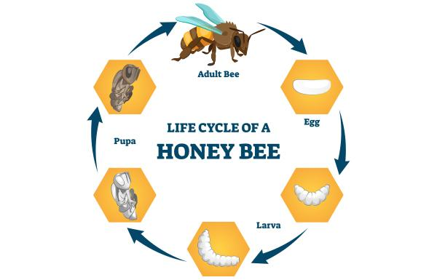
This project has received funding from the European Union’s Horizon 2020 research and innovation
programme under the Marie Skłodowska-Curie grant agreement No 956696.
It is about WHAT to buy!
Moving away from lowest price
Focus on life-cycle
Nudging markets
Limiting MSs/CAs discretion
And WHOM not to buy from

Slide 19

This project has received funding from the European Union’s Horizon 2020 research and innovation
programme under the Marie Skłodowska-Curie grant agreement No 956696.
SPP Approaches
Exclusions: info?
Targets: controls!
SPP criteria: takes time!
Any alternative?

Slide 20
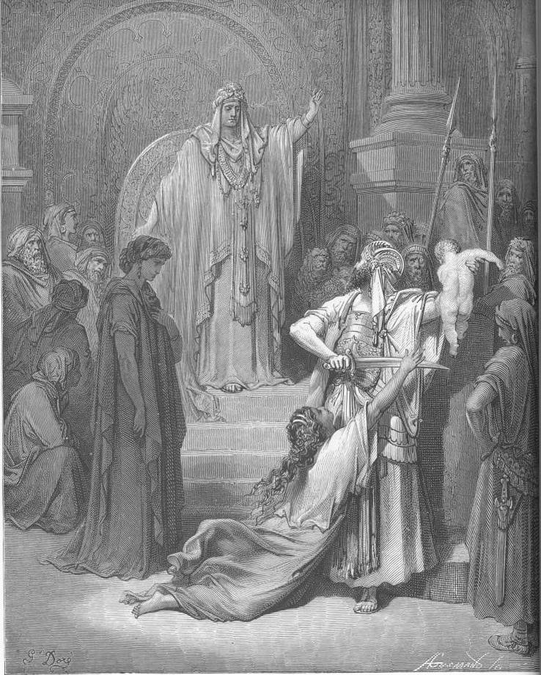
possible effects
on review bodies

Slide 21

This project has received funding from the European Union’s Horizon 2020 research and innovation
programme under the Marie Skłodowska-Curie grant agreement No 956696.
Remedies
Civil society litigation comes to public procurement

Slide 22

This project has received funding from the European Union’s Horizon 2020 research and innovation
programme under the Marie Skłodowska-Curie grant agreement No 956696.
STANDING?
Integrity
CSR
Art. 9 Aarhus Convention
https://realaw.blog/2022/11/01/opening-the-doors-to-civil-society-litigation-in-public-contracts-by-r-caranta/

Slide 23

This project has received funding from the European Union’s Horizon 2020 research and innovation
programme under the Marie Skłodowska-Curie grant agreement No 956696.
SPP Approaches
Exclusions
Targets
SPP criteria

Slide 24

This project has received funding from the European Union’s Horizon 2020 research and innovation
programme under the Marie Skłodowska-Curie grant agreement No 956696.
Contract changes?
MSs shall ensure that contracting authorities have the possibility, at least under the following circumstances and under the conditions determined by the applicable national law, to terminate a public contract during its term, where (a) the contract has been subject to a substantial modification, which would have required a new procurement procedure pursuant to Article 72

Slide 25

QUO VADIS REMEDIES?
Damages
(part of climate litigation)?
Injunctions?
Termination?
This project has received funding from the European Union’s Horizon 2020 research and innovation
programme under the Marie Skłodowska-Curie grant agreement No 956696.

Slide 26


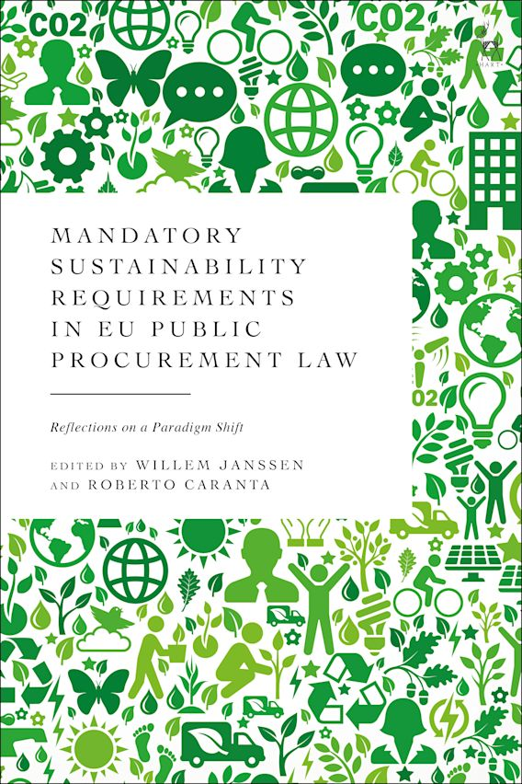
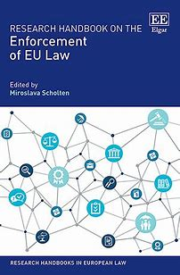
THANK YOU
This project has received funding from the European Union’s Horizon 2020 research and innovation
programme under the Marie Skłodowska-Curie grant agreement No 956696.

